Slide 1

Web Service Intro
www.pragmatic.bg
Lector: Dimitar Topuzov
E-mail: dtopuzov@gmail.com
LinkedIn: http://bg.linkedin.com/pub/dimitar-topuzov/18/470/833/en
Copyright © Pragmatic LLC 2018

Slide 2
Content
What is Web Service
Why Web Services
Multitier Software Architectures
Web Services in context of Multitier Software Systems
Testing Web Services
Approaches & Tools

Slide 3
What is a Service
In the real world a "service" is:
A piece of work performed by a service provider
Provides a client (consumer) some desired result by some input parameters
Has quality characteristics
Price, execution time, constraints, etc.

Slide 4
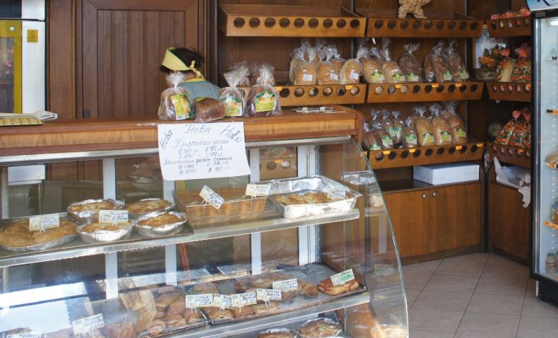
Example

Slide 5
What is a Web Service
Web services are services that can be accessed over a network
Takes some input, do some work and produces some output
Request-Response model:
Client request, server responses
Notes:
Web services are services that can be accessed over a network, for instance via the global internet. Often these web services and their clients communicate via web protocols like HTTP.

Slide 6
What is a Web Service
“ A software system designed to support interoperable machine-to-machine interaction over a network… "
W3C definition

Slide 7
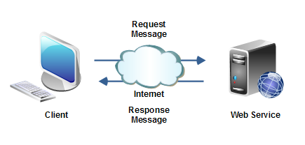
Web Service and Client
.NET Web Application
Weather service implemented in Java
Runs on Window
Runs on Linux

Slide 8
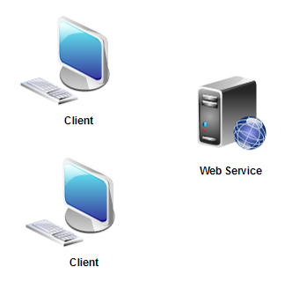
Why Web Services
Reuse application components
Ideally, there will only be one type of each application component, and anyone can use it in their application

Slide 9
Monolithic Apps
Web: ASP .NET
Android: Java
iOS: Objective C
App
UI & Logic
App
UI & Logic
App
UI & Logic
DB Layer

Slide 10
Multitier Architecture
Web
Android
iOS
UI Layer
UI Layer
UI Layer
Service Layer
DB Layer

Slide 11
Multitier Architecture
UI Layer
Presentation
Service Layer
Business logic
DB Layer
Data storage

Slide 12
Multitier Architecture
UI Layer
Service Layer
How to test it?
DB Layer

Slide 13

Testing Service Layer
Benefits:
Good way to test business logic
Faster tests
Less fragile
Lower Maintenance
Disadvantages:
Not testing what user actually use and see
UI Layer
Service Layer
DB Layer

Slide 14

Testing UI Layer
Benefits:
Test what user see
Disadvantages:
Slower
More Fragile
Higher Maintenance Cost
UI Layer
Service Layer
DB Layer

Slide 15
Testing Both Layers (1)
Benefits:
Test both Service and UI Layer
Disadvantages:
No reuse of code, build and CI infrastructure, reporting tools, etc.
UI Layer
Service Layer
DB Layer

Slide 16

Testing Both Layers (2)
Benefits:
Single Code Base
Reuse Code, CI infrastructure, reporting tools, etc
Disadvantages:
Might be a bit hard to setup for first time
UI Layer
Service Layer
DB Layer

Slide 17
Single Code Base Solution
Popular Service Layer Testing Libraries
Java
Rest-assured (see this Simple Project)
Jersey
Axis (for SOAP Services)
.NET
HTTP Client & Json.NET
RestSharp
Sample Project

Slide 18
REST Assured
What is REST Assured
Testing and validation of REST services in Java is harder than in dynamic languages such as Ruby and Groovy.
REST Assured brings the simplicity of using these languages into the Java domain.
Resources
Web Site: http://rest-assured.io/
GitHub Repo: https://github.com/rest-assured/rest-assured
Wikis: https://github.com/rest-assured/rest-assured/wiki
3.0.0 Release Notes
Getting Started (up to date with 3.0.0)

Slide 19
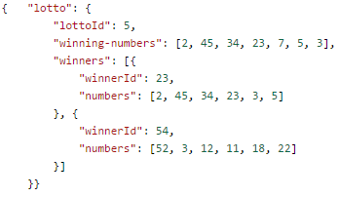
REST Getting Started
Another Test
get("/lotto").then().body("lotto.winners.winnerId", hasItems(23, 54));

Slide 20
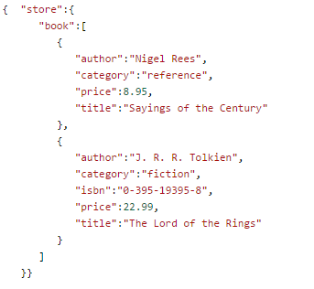
REST Getting Started
when().get("/store").
then().
body("store.book.findAll { it.price < 10 }.title", hasItems("Sayings of the Century"));

Slide 21
REST Getting Started
Send Requests
Add Parameters
Add Headers
given().
param("x", "y").
header("z", "w").
when().
get("/something").
then().
statusCode(200).
body("x.y", equalTo("z"));

Slide 22
REST Getting Started
Extract values after validation
String id =
when()
.get(baseURL + "book/{id}", "2279690981")
.then()
.statusCode(200)
.extract()
.path("ID").toString();
Assert.assertEquals("Id is not correct", "2279690981", id);

Slide 23
Demo
Test google search for temperature
It will return temperature in current location
How to check it when it is dynamic?
Just check UI show the same value as the API
We have no access to google temperature APIs so we will use OpenWeather APIs.

Slide 24

Questions

